Slide 1



Highest Level of Meeting Preparation
25% More Effective Meetings
Execute Meetings like a Pro
www.meetingbooster.com

Slide 2
Why We Love to Hate Meetings
Based on a survey of 948 Executives and Managers
40%
60%
50%
42%
40% don’t start or end on time
60% nothing gets accomplished
50% no clear agenda
42% were missing decision makers
You need meetings…so make them work for you.

Slide 3
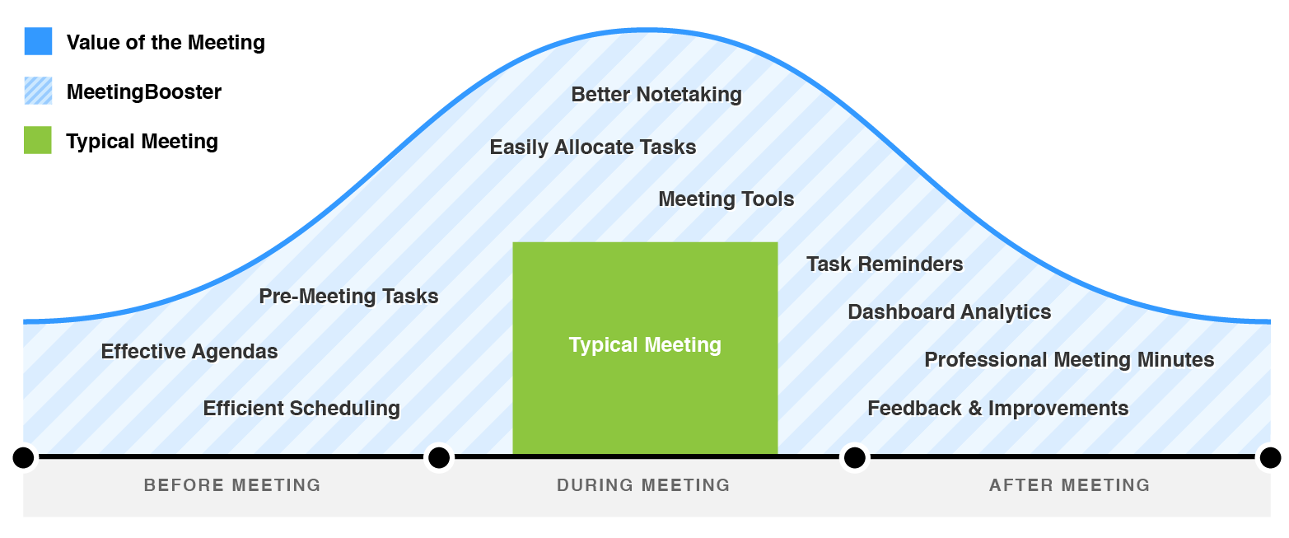
Value of Meetings

Slide 4

Why MeetingBooster
ROI – Save Time On Meetings
Simplify scheduling
Create agendas more efficiently
Auto-generation & archiving of minutes
Auto-distribution of minutes and tasks
Average time saved per meeting – 30 min!!

Slide 5
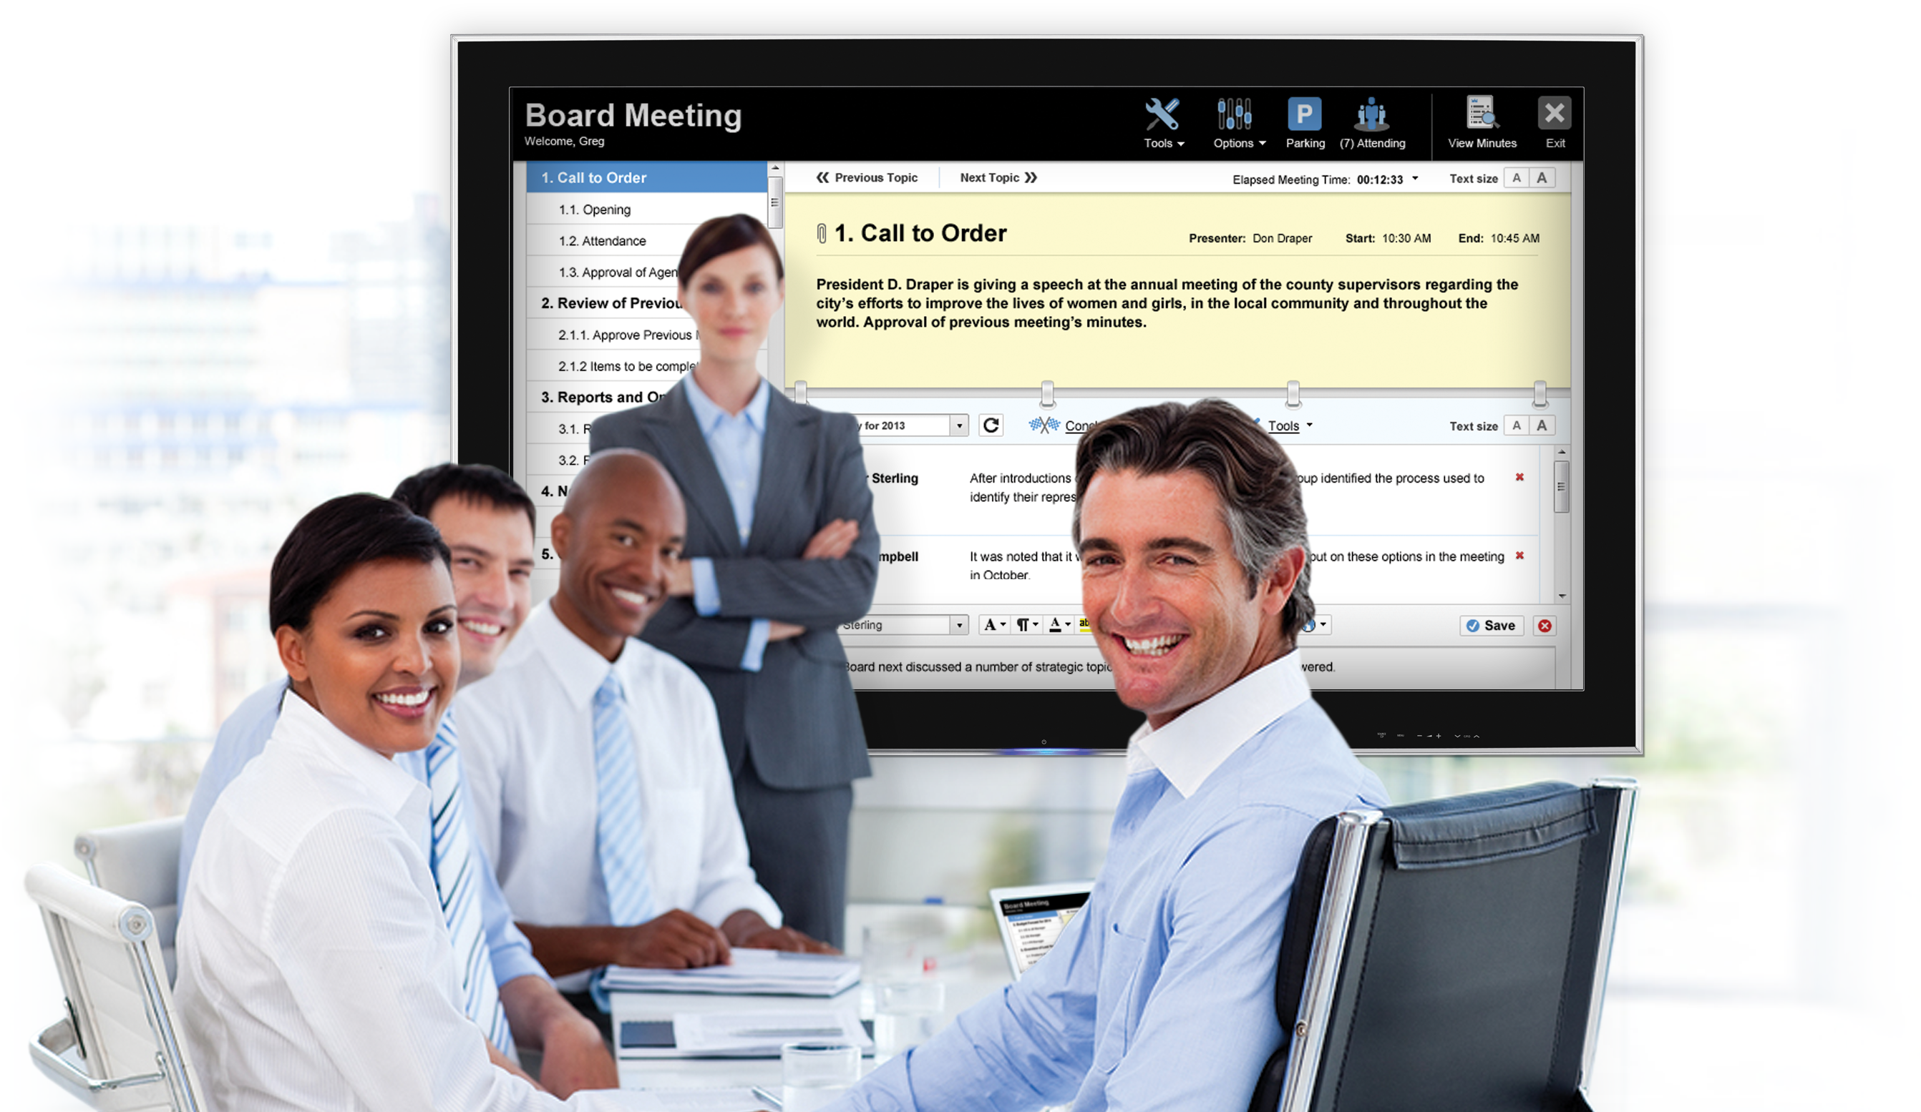
Why MeetingBooster
Boost Productivity
Improve attendee engagement
Turn discussions into action plans
Automatic backup of meeting minutes
Global search of all meeting minutes
Running a successful meeting – Priceless!!

Slide 6
Hosting Models
Cloud Hosting
On-Premise Hosting
Hosted by Microsoft Windows Azure
Quick to deploy with less effort
Minimal investment in technology
Maintenance handled by MatchWare
Protected by company firewall
Total control over hardware and software
No transmission or storage of data off-site

Slide 7

How MeetingBooster Works
1.
Schedule Meeting
in Outlook
Schedule your
meeting like a normal Outlook meeting. No change in scheduling habits.
2.
Create Agenda
Create your agenda in MeetingBooster’s online Agenda module. Use templates, allocate topic times, and assign pre-meeting tasks.
3.
Run The Meeting
Run your onsite or online meeting using MeetingBooster Meeting module. Take notes, allocate tasks, use voting tools, etc.
4.
Auto-Generate Meeting Minutes
MeetingBooster auto-generates, distributes, and archives meeting minutes and tasks.

